Slide 1
FRONT-END PROJECT CLOTHING WEBSITE
By:
AJAY R M
Batch :2021-5879

Slide 2
OBJECTIVE
The objective of a clothing website is to provide the customers with various choices of clothing at one online store. Online clothing website makes it easy for the customers to buy clothes from the comfort of their homes.

Slide 3
INTRODUCTION
This website provides a convenient way for customers to view and buy products.
The products can be ordered online and will be delivered to the customers home.
Customers can create their own account and login to buy products.

Slide 4
LANGUAGES USED
HTML
CSS
JAVASCRIPT

Slide 5
SECTIONS AVAILABLE
HOME with 4 different slides
NEW ARRIVALS
FEATURED
GALLERY
DEALS
LOGIN/REGISTER FORMS

Slide 6
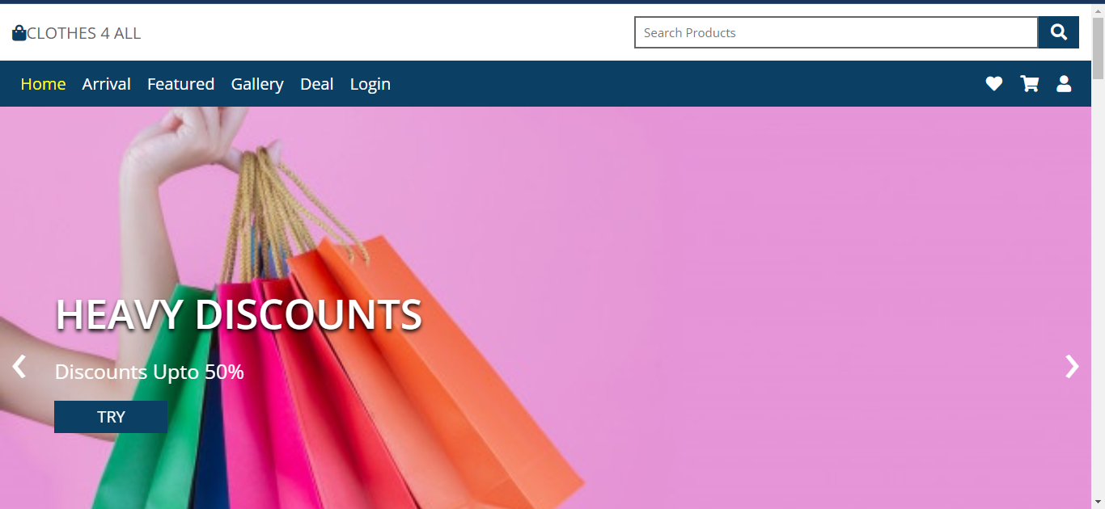
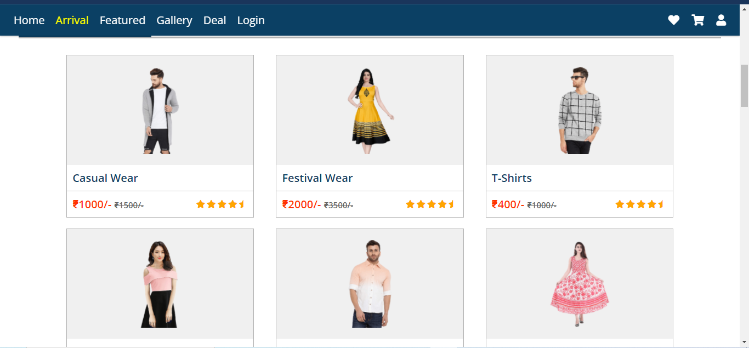
SCREENSHOTS

Slide 7
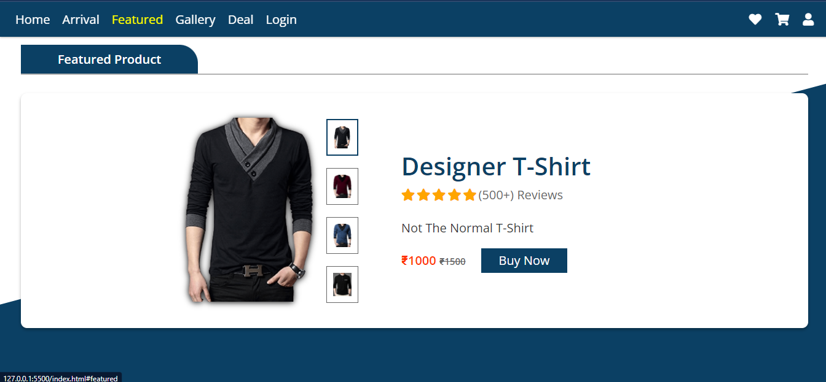
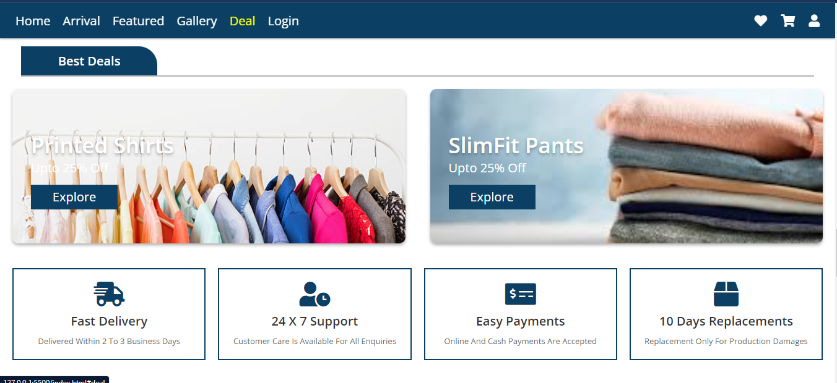
SCREENSHOTS

Slide 8
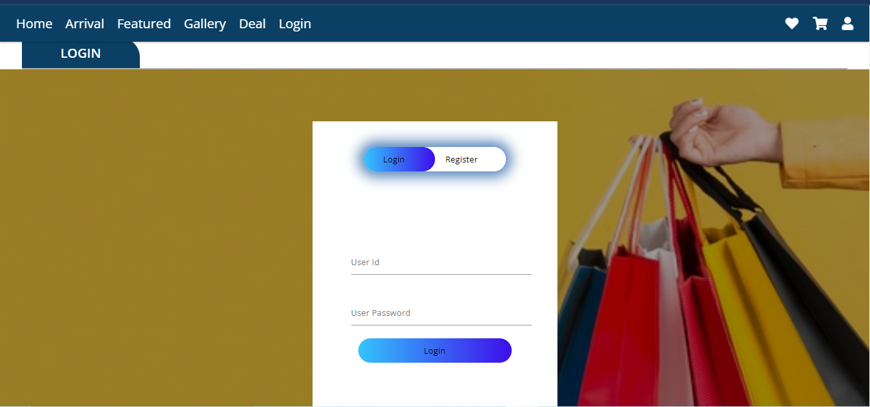
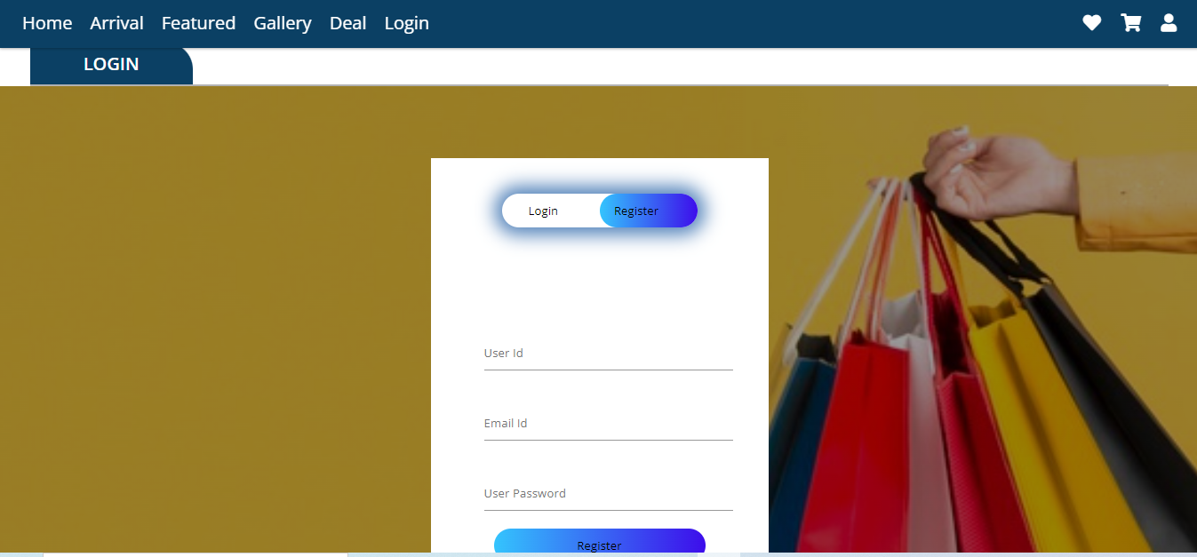
SCREENSHOTS

Slide 9
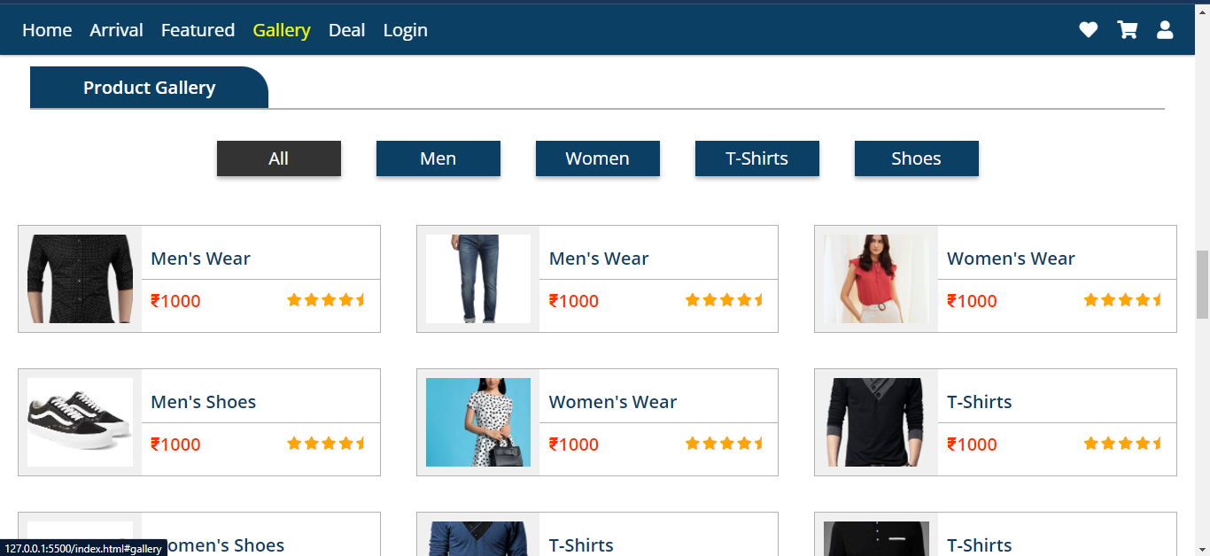
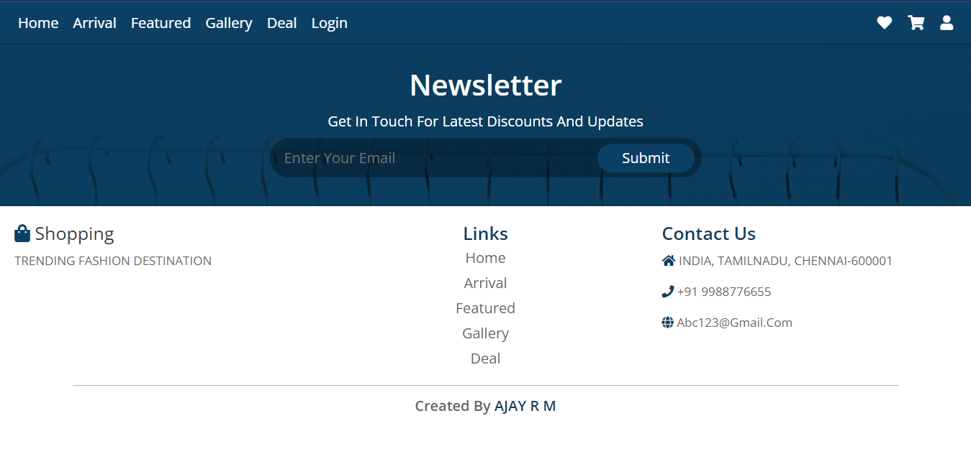
SCREENSHOTS

